Slide 1


DEPARTMENT OF ARTIFICIAL INTELLIGENCE AND DATA SCIENCE
SCHOOL OF COMPUTING
10214AD602 MINOR PROJECT -II
WINTER SEMESTER(2023-2024)
SEMESTER END PROJECT VIVA VOICE EXAMINATIONS
“CHILI LEAF DISEASE PREDICTION USING DEEP LEARNING”
SUPERVISED BY
PRESENTED BY
MR. M. DHARMA TEJA ,M.TECH
1.ANNAPUREDDY MANASA (VTU21099)(21UEAD0002)
2.PUNURI VIDHYULLATHA(VTU19419)(21UEAD0050)
3.DEVAKI VENKATA SAI PAVAN KUMAR(VTU20590)(21UEAD0014)

Slide 2
OVERVIEW
ABSTRACT
OBJECTIVE
INTRODUCTION
LITERATURE REVIEW (SOFT COPY OF PAPERS TO BE LINKED AS HYPERLINK)
DESIGN AND METHODOLOGIES
IMPLEMENTATION
TESTING
INPUT AND OUTPUT
INCLUDE DEMO VIDEO
CONCLUSION
FUTURE ENHANCEMENTS
SOCIETAL IMPACT OF PROJECT
WEB REFERENCES LINK (TILL REVIEW DATE ALL LINKS TO BE INCLUDED DAY WISE)
PLAGIARISM REPORT OF PPT
POSTER PRESENTATION
REFERENCES

Slide 3
ABSTRACT
Chili leaf diseases cause considerable damage to chili plants, resulting in lower agricultural yields and economic losses for growers.
Early detection and diagnosis of these disorders are critical to optimal disease management. In this publication, we propose a Convolutional Neural Network (CNN)-based illness prediction model for chili leaves
The suggested model makes use of an image dataset obtained from various places, which includes chili leaf images infected with common chili leaf diseases such as bacterial leaf spot, leaf curl, and mosaic virus. We pre-processed the dataset to improve image quality and reduce noise.
The pre-processed data was divided into training and validation sets. The training set was used to train the CNN model, which was then validated.
The proposed model performed well on the validation set. The suggested approach may be used to anticipate the occurrence of chili leaf diseases in real time, allowing farmers to take proactive steps to preserve their crops.

Slide 4
OBJECTIVES
Aim of the project : This project aims to help chili farmers accurately identify diseases that can affect the crop. By using deep learning techniques, the project intends to provide a reliable tool for the early detection of diseases, enabling timely intervention and improved crop management practices.
Scope of the project :
The scope of the chili leaf disease prediction project encompasses the collection and preprocessing of a diverse dataset of chili leaf images.
Development and training of a deep learning model for accurate disease classification, evaluation and validation of the model's performance, hyperparameter tuning and optimization for enhanced efficacy.

Slide 5
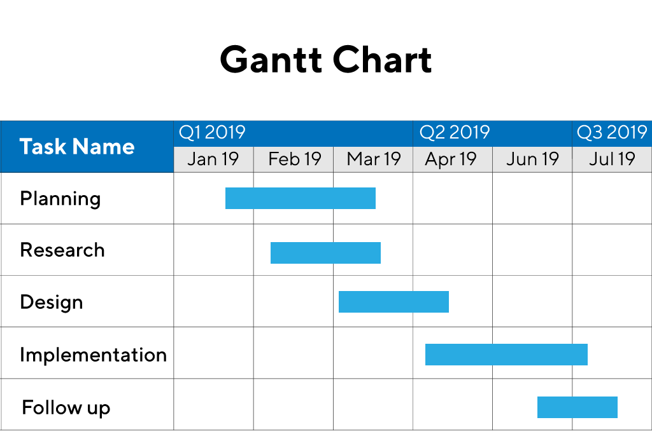
TIMELINE OF THE PROJECT
Sample Gantt Chart
Include as GANTT CHART
Include timeline from October 2023 to January 2024.

Slide 6
INTRODUCTION
A significant crop that is farmed all over the world for both culinary and medicinal purposes is chili.
Nevertheless, a number of illnesses, such as bacterial leaf spot, leaf curl, mosaic virus, etc., can affect chili plants.
These illnesses seriously harm chili plants, which lowers crop yields, lowers crop quality, and costs farmers money.
Effective disease management depends on the early identification and detection of these conditions. Disease diagnosis is traditionally expensive and time-consuming.
It is now feasible to create automated disease prediction models that can identify and diagnose diseases of the chili leaf thanks to the development of machine learning techniques.
A deep learning method , Convolutional Neural Networks (CNN) shows stimulating performance in picture recognition and classification applications.
In this project, we provide a CNN-based model for the illness prediction of chili leaf. On a dataset of photos of chili leaves gathered from various locations, the suggested model can be utilized for training and testing.
The program is able to identify different kinds of illnesses in chili leaves.
The main goal of the suggested approach is to enable farmers take proactive steps to protect their crops by helping them predict the occurrence of chili leaf diseases in real-time.

Slide 7
LITERATURE REVIEW
Sl.No | Author’s Name | Paper name and publication details | Year of publication | Main content of the paper
1 | Sladojevic et al. | Deep Neural Networks Based Recognition of Plant Diseases by Leaf Image Classification | 2016 | a CNN-based model was used to classify images of plant leaves affected by six different diseases. The model achieved an accuracy of 98.34%, demonstrating the potential of CNN for plant disease detection
2 | Barbedo | Factors influencing the use of deep learning for plant disease recognition | 2018 | NN-based model for detecting soybean diseases. The model achieved an accuracy of 96.08% in detecting four different diseases, outperforming other state-of-the-art methods. The proposed model was also shown to be robust to variations in image acquisition conditions, such as lighting and camera angle.

Slide 8
3 | B. Nageswararao Naik | Detection and classification of chilli leaf disease using a squeeze-and-excitation-based CNN model | 2022 | Plant disease detection using deep learning and computer vision has been the subject of maximum research over the last decade. Conventional computer vision algorithms such as Haar, histogram of oriented gradients, scale invariant and feature transform, speeded-up robust features, support vector machine (SVM), and image segmentation using artificial neural networks, K-nearest neighbours (KNN), and K-means clustering methods of machine learning algorithms have been used for plant disease detection.
4 | Mohanty et al |  | 2016 | CNN-based model to classify images of plant leaves affected by 14 different diseases. The model achieved an accuracy of 99.53% in detecting diseases, outperforming other state-of-the-art methods. The authors also proposed a mobile application based on the model, which could be used by farmers to detect and diagnose plant diseases in real-time.

Slide 9
DESIGN AND METHODOLOGIES
MODULE 1: Dataset Collection
MODULE 2: Image Pre-processing
MODULE 3: Image Segmentation
MODULE 4: Classification Using CNN
MODULE 5: Training Process
MODULE 6: Testing and Evaluation

Slide 10
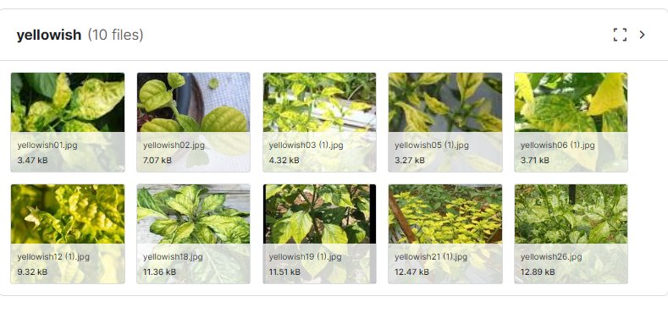
MODULE 1: Dataset Collection
Collection of data:
The dataset used in this study consists of chili leaf images collected from different regions. The dataset contains images of healthy chili leaves, as well as leaves affected by various diseases, including bacterial leaf spot, leaf Curl, white leaf etc . The dataset was collected by the different online sources like Kaggle and GitHub, etc.

Slide 11
Module 2- Image Pre-processing
Image pre-processing plays a crucial role in the successful application of Convolutional Neural Networks (CNNs) for chili leaf disease prediction. It involves a series of operations performed on the input images to enhance their quality, reduce noise, and extract relevant features. Here is an overview of the common image pre-processing steps for chili leaf disease prediction using CNN:
1. Image Acquisition
2. Image Resizing
3. Grayscale Conversion
4. Image Enhancement
5. Noise Reduction
6. Normalization
7. Data Augmentation
8. Feature Extraction

Slide 12
Module 3: Image Segmentation
A picture is segmented by breaking it up into several sections or segments, each of which corresponds to a different item or area of the image. The ability to identify and isolate particular plant components that are pertinent to the disease can be valuable for a variety of purposes, including disease detection. In this instance, we employ k-means clustering for picture segmentation.
K-means Clustering: Initializing a certain number of cluster centre’s—representative locations within the dataset—is the first step in the k-means algorithm's operation. These cluster centres would line up with the beginning positions of the segments inside the picture in the case of image segmentation.
Using a similarity metric like colour or intensity, the computer then iteratively allocates each pixel in the picture to the closest cluster centre. The cluster centres are updated with the new mean values of the pixels in the cluster after all of the pixels have been allocated. This procedure is continued until the clusters converge and no more updates are needed. K-means clustering for picture segmentation has the benefit of being both easily understandable and computationally effective. Due to the ease with which the number of clusters may be defined and altered, it is also quite versatile. The k-means method is also capable of handling big datasets and high-dimensional data, which makes it suitable for picture segmentation.

Slide 13
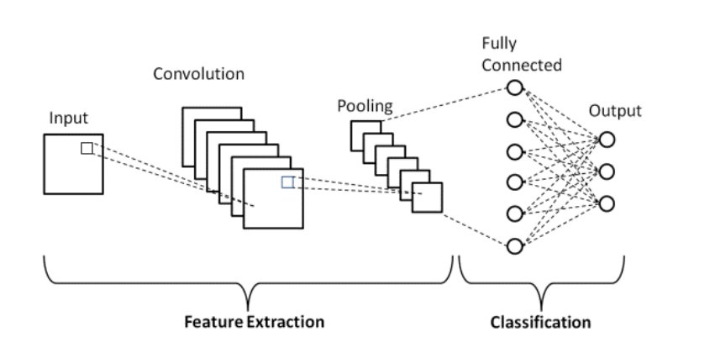
Module 4: Classification Using CNN
The proposed CNN model consists of four convolutional layers, followed by two fully connected layers and a softmax activation layer for classification. Each convolutional layer is followed by a max-pooling layer, which reduces the spatial dimensions of the feature maps and extracts the most relevant features. The number of filters in each convolutional layer was gradually increased to capture more complex patterns in the input images.

Slide 14
Module 5: Training Process
The proposed model was trained with a learning rate of 0.001. The model was trained for 50 epochs, and the batch size was set to 32. The training process was performed on a GPU for faster processing. The model's performance was evaluated using the accuracy and loss metrics, and the model's hyperparameters were tuned to improve its performance.
Module 6: Testing and Evaluation
The trained model was evaluated using a test set consisting of chili leaf images not used in the training process. The model's performance was evaluated based on its accuracy, precision, recall, and F1-score. The confusion matrix was also used to visualize the model's performance in detecting various chili leaf diseases.
Overall, the proposed methodology aims to develop a CNN-based model for predicting chili leaf diseases accurately. The proposed model's architecture, training process, and evaluation metrics were carefully designed to ensure its accuracy and relevance to the agricultural industry. The next section presents the results obtained from the experiments conducted on the proposed model.

Slide 15
IMPLEMENTATION
Architecture Diagram
Data –Flow Diagram
Use Case Diagram
Class Diagram
Activity Diagram
Sequence Diagram
Collaboration Diagram(If applicable)

Slide 16
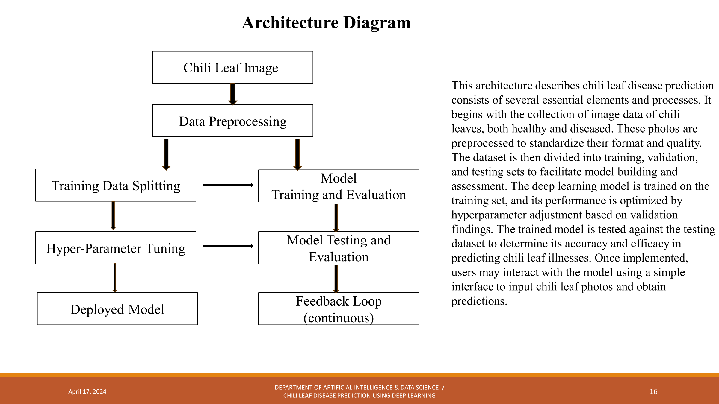
Architecture Diagram
Include the architecture diagram and briefly explain it.
The explanation should be in bullet points only.
It’s a sample only and may vary according to the project

Slide 17
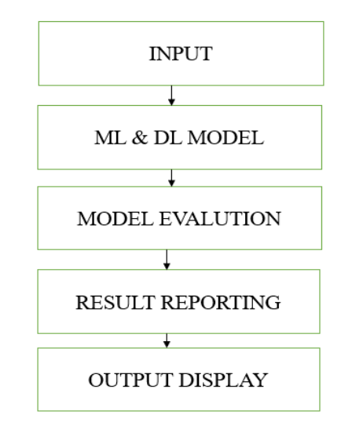
Data –Flow Diagram
The data flow diagram illustrates the various stages in the chili leaf disease prediction system. It starts with the gathering of chili leaf photos, which is then preprocessed to normalize the data before analysis. The preprocessed pictures are then divided into training and testing datasets to help in model development and assessment. The training dataset is then used to create and train a Convolutional Neural Network (CNN) model. Once trained, the model can predict fresh chili leaf pictures based on the known parameters. This simplified data flow depicts how data moves through the system, from raw input to illness prediction output.

Slide 18
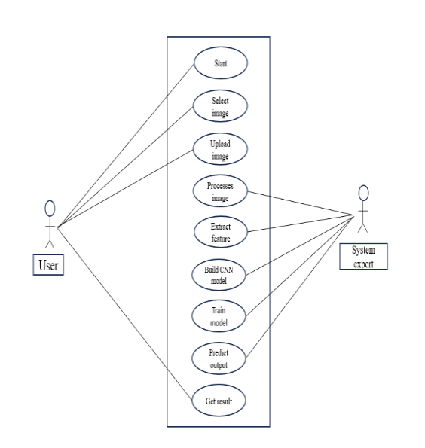
Use Case Diagram
This use case diagram illustrates the series of contacts between the user and the chili leaf disease prediction system. First, the user submits a picture of a chili leaf to the system for analysis. The algorithm then examines and analyzes the submitted picture to detect any indicators of sickness. Following the analytical results, the system assesses the disease state of the chili leaf. Finally, the system shows the user the expected illness state, offering useful information about the chili plant's health. Overall, this use case demonstrates how the system helps users diagnose and manage chili leaf illnesses via picture analysis and prediction.

Slide 19
Class Diagram
Chili Leaf Image
Image_data : image Label :str
Get_image_data() : image Get_label():str
Chili Leaf Image
Image_data : image Label :str
Get_image_data() : image Get_label():str
Preprocessing module
Preprocessing_parameter: dict
Image preprocessing
Preprocess_image()
model
Architecture: str Parameter: dict
Load_model() Save_model()
Deplayemodel
Model : model
predict(image: image):str
Deplayemodel
Model : model
predict(image: image):str

Slide 20
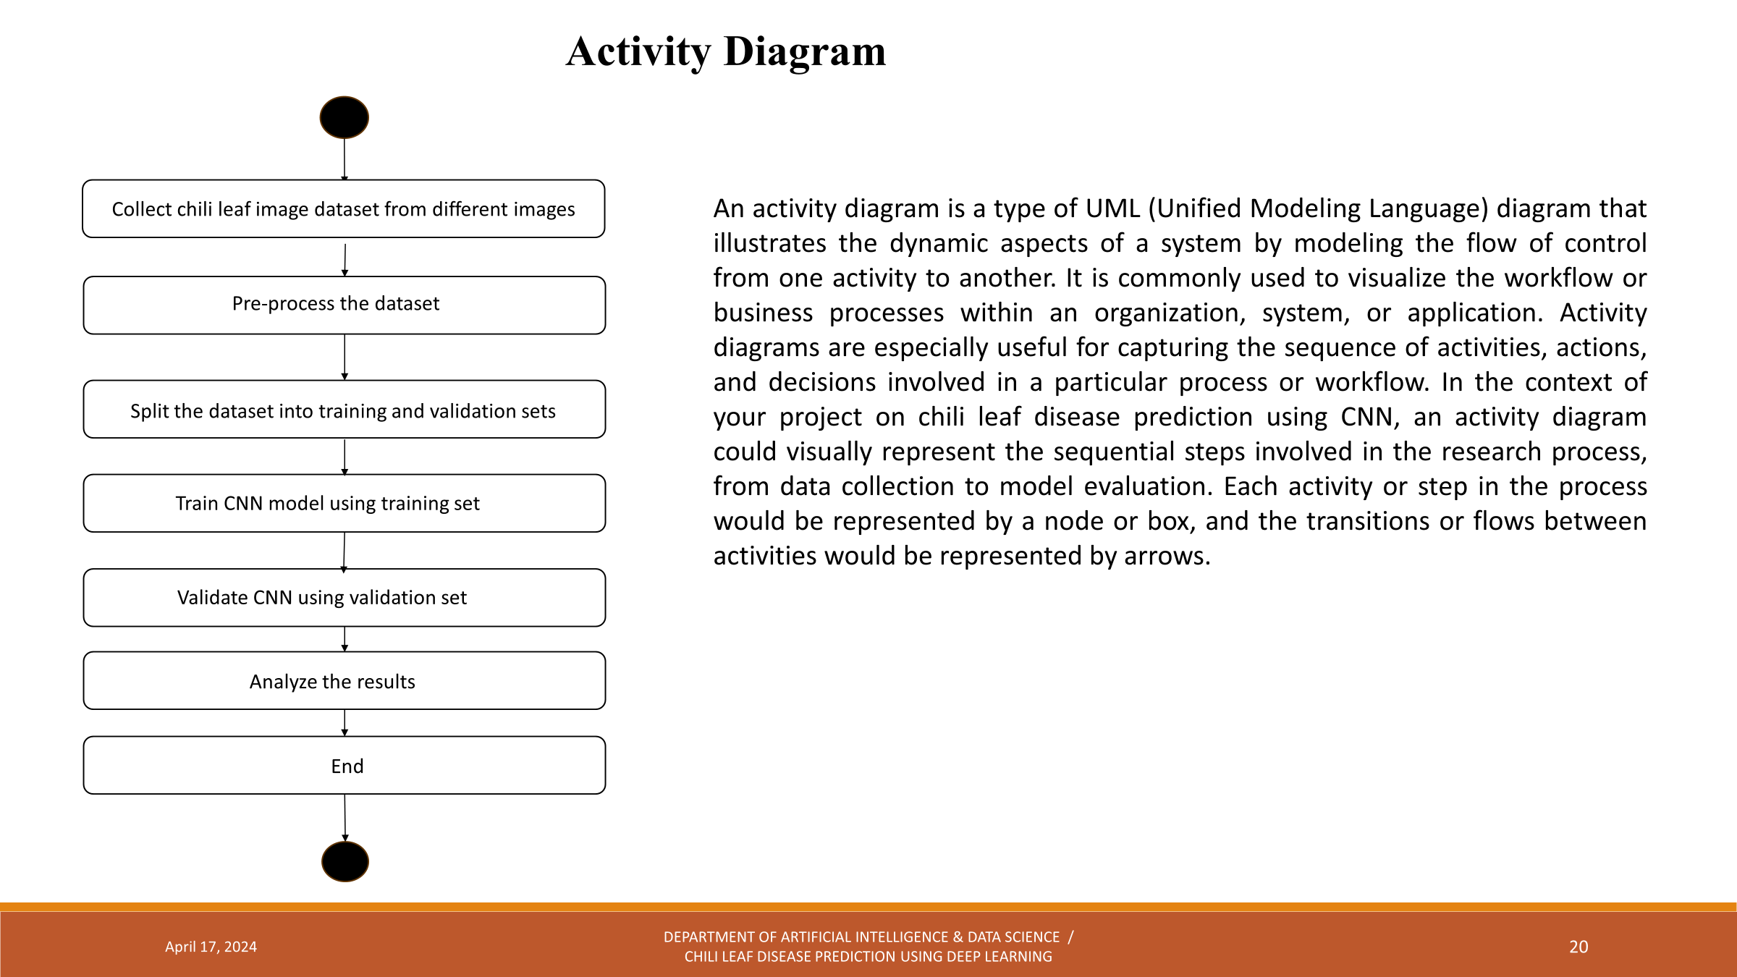
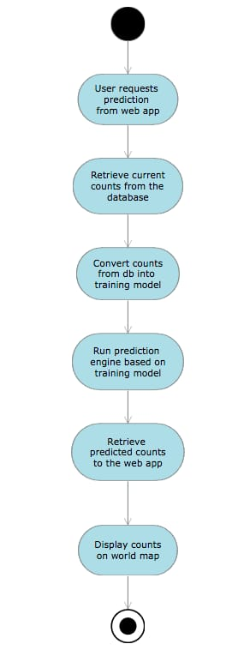
Activity Diagram
Eg,

Slide 21
Sequence Diagram
This sequential flow diagram demonstrates operations involved in creating and deploying a deep learning model for chili leaf disease prediction. It starts with the collecting of chili leaf photos, which are then preprocessed for uniformity and quality. The preprocessed dataset is divided into training and testing sets for model development and assessment, respectively. Hyperparameter adjustment improves the model's performance, and it is tested to ensure correctness. Once implemented, the model can forecast chili leaf illnesses in real time. Continuous user input and monitoring data drive a feedback loop, allowing for iterative improvements to the model's performance over time.
Data Collection
Preprocessing Module
Model Training and Evaluation
Image data
Model Evalution and Hyper-parameter Tuning
Trained model
Model performance metric
Model Development Environment
Model Testing and Evaluation
Deployed Model

Slide 22
TESTING
UNIT TESTING
INTEGRATION TESTING
FUNCTIONAL TESTING
WHITE BOX TESTING
BLACK BOX TESTING

Slide 23
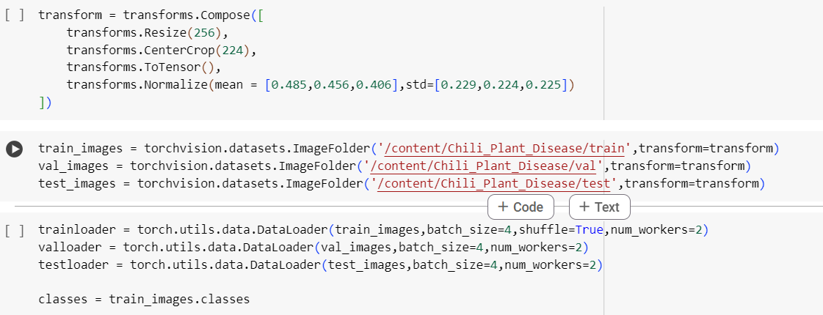
UNIT TESTING
Model Training Unit Testing:
Unit tests can be written to validate the training process of the machine learning model. This includes testing functions or methods responsible for initializing the model, transformation resizes the input image and executing the training loop. It will also test the functionality of the code that loads the image data from the specified directories (train, val, and test) and test the behavior of the image transformation functions (e.g., transforms.Resize, transforms.CenterCrop, transforms.ToTensor, and transforms.Normalize).
Screenshot:

Slide 24
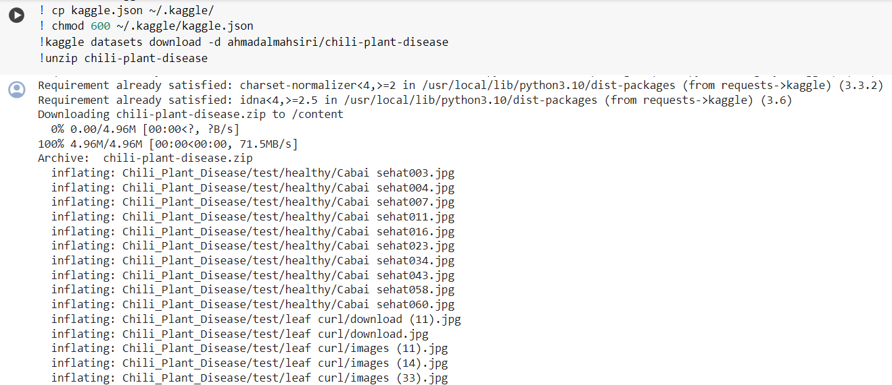
SYSTEM TESTING
System testing involves testing the entire integrated system as a whole to verify that it meets the specified requirements and behaves as expected. In the case of the chili leaf disease prediction model, system testing could include:
End-to-End Testing: Test the complete end-to-end workflow of the system, from uploading or providing an image to receiving the predicted disease output. This could involve manual testing or automated testing using tools like Selenium for web applications.

Slide 25
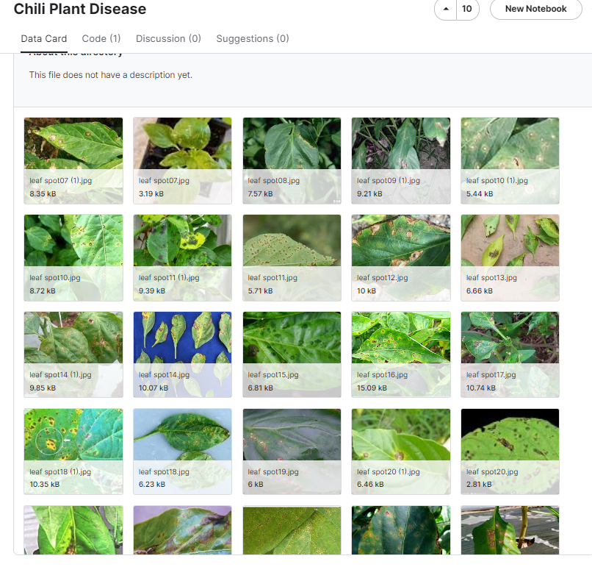
INPUT AND OUTPUT
DATASET IMAGE

Slide 26
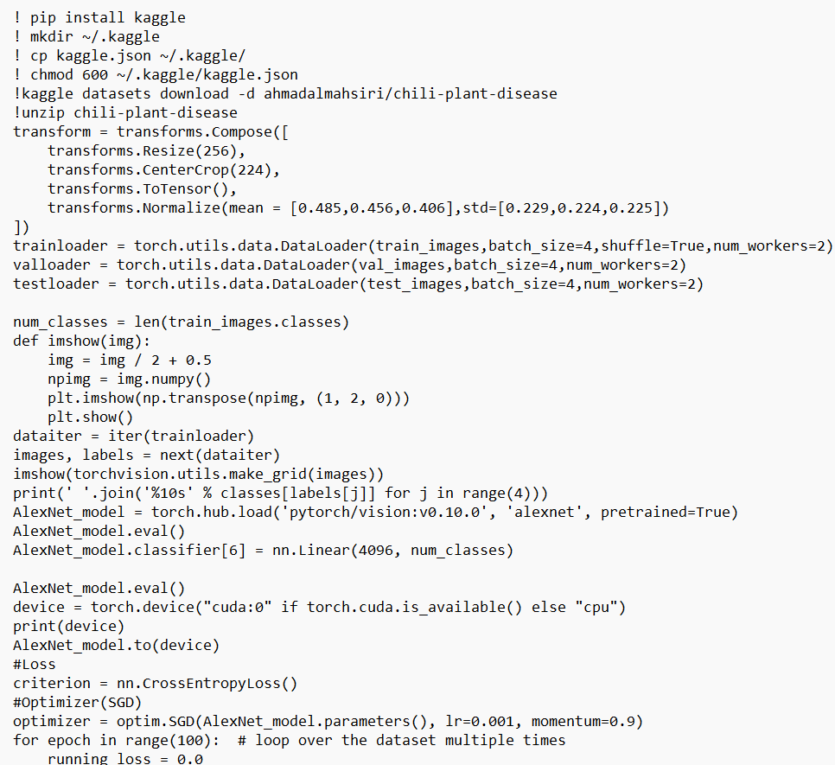
SOURCE CODE

Slide 27
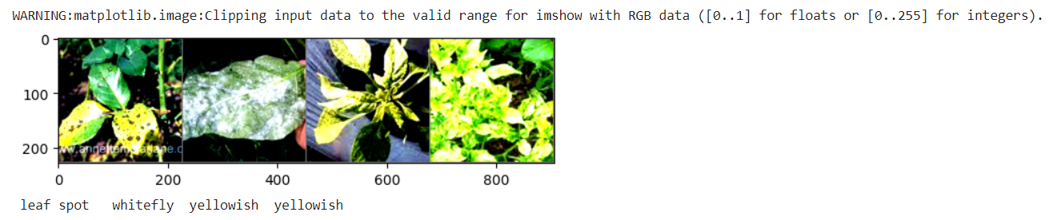
OUTPUT

Slide 28
CONCLUSION
In conclusion, we created a deep learning model to predict the state of chili leaves, with an emphasis on the presence of illnesses.
Our program takes in photos of chili leaves and accurately classifies them as 'good' or 'bad', indicating the presence of disease.
This tool can greatly assist farmers and agricultural professionals in the early detection and management of chili plant diseases, resulting in increased crop output and quality.
Moving forward, more research and development can improve the accuracy and efficiency of such models, helping to promote sustainable agriculture practices."
The development of a reliable deep learning model for predicting chili leaf disease is a big step toward sustainable agriculture methods.
By allowing for early identification and treatment of plant diseases, our model can help to reduce dependency on chemical pesticides, promote ecologically friendly farming methods, and provide a more secure food supply chain.

Slide 29
FUTURE ENHANCEMENTS
In comtemplating future enhancements for the chili leaf disease prediction project. First off, the model's usefulness would be greatly increased if it could be made to classify chili leaf diseases into more than one class. Farmers could obtain more accurate insights into the health state of their crops, enabling tailored treatment techniques and enhancing crop management practices, by training the model to identify specific illnesses rather than just differentiating between healthy and unhealthy leaves. Farmers may be able to take proactive steps to contain and mitigate the spread of diseases within their chili plants by using techniques for disease localization and leaf segmentation within the images. This could give farmers more precise information about the scope and location of disease outbreaks.
Adding real-time monitoring capabilities to the system is another exciting avenue for future development. Farmers would be able to continuously evaluate the health of their crops if a monitoring system with cameras or drones that could take pictures of chili plants in fields was developed. Farmers might receive rapid feedback on the disease state of their chili leaves by including the disease prediction model into this monitoring system. This would enable prompt interventions and proactive management of disease outbreaks. The accessibility and usability of the system would also be improved by the creation of a mobile application that would allow farmers to take and submit pictures of chili leaves for disease prediction while on the road.

Slide 30
SOCIETAL IMPACT OF PROJECT
The chilli leaf disease prediction project can have significant societal impacts, particularly in regions where chilli cultivation is an important agricultural activity and a source of livelihood for many farmers. Here are some potential societal impacts of this project:
Improved crop yield and productivity: Accurate prediction and early detection of chilli leaf diseases can help farmers take timely preventive measures or implement appropriate treatments. This can reduce crop losses and improve overall yield and productivity, thereby enhancing the economic well-being of chilli farmers.
Food security: Chillies are an important ingredient in many cuisines around the world, and their production contributes to food security. By minimizing crop losses due to leaf diseases, this project can help ensure a stable supply of chillies, which is particularly important for regions where chillies are a staple food item.
Reduced pesticide usage: With early detection and accurate identification of leaf diseases, farmers can adopt targeted and judicious use of pesticides or explore eco-friendly alternatives. This can reduce the environmental impact of excessive pesticide usage and promote sustainable agricultural practices.
Economic benefits: Increased crop yield and reduced crop losses can translate into better economic returns for chilli farmers, improving their financial stability and standard of living. This can have a positive ripple effect on local economies and communities that depend on chilli cultivation.

Slide 31
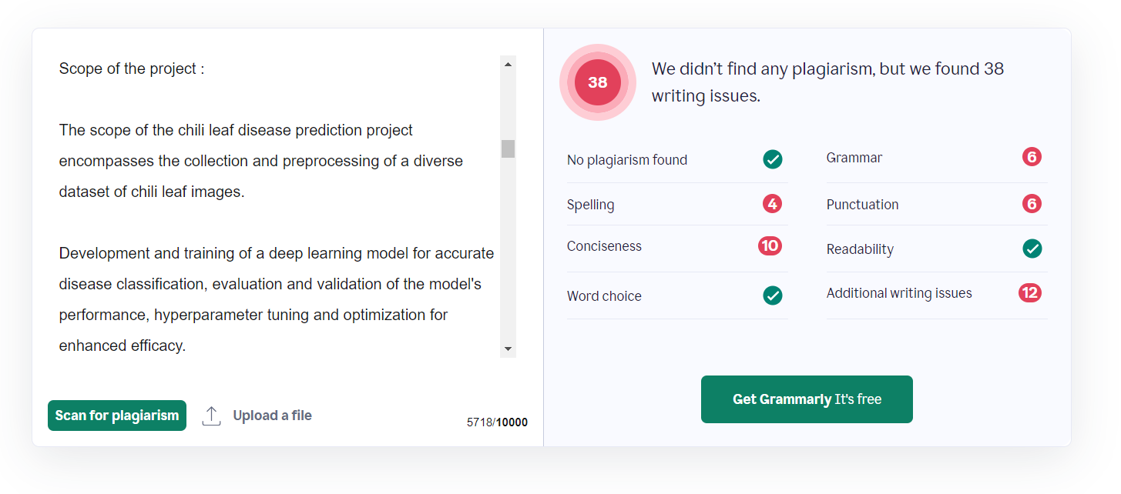
Plagiarism Report of PPT

Slide 32
Web references/video links
https://youtu.be/dGtDTjYs3xc?si=H1rwqQere9cEeWei
https://www.ijraset.com/best-journal/chili-leaf-disease-prediction-using-cnn
https://www.frontiersin.org/articles/10.3389/frobt.2021.650134/full
https://www.researchgate.net/publication/261395340_Feasibility_Study_on_Plant_Chili_Disease_Detection_Using_Image_Processing_Techniques
https://www.academia.edu/70393766/Disease_Identification_in_Chilli_Leaves_using_Machine_Learning_Techniques

Slide 33
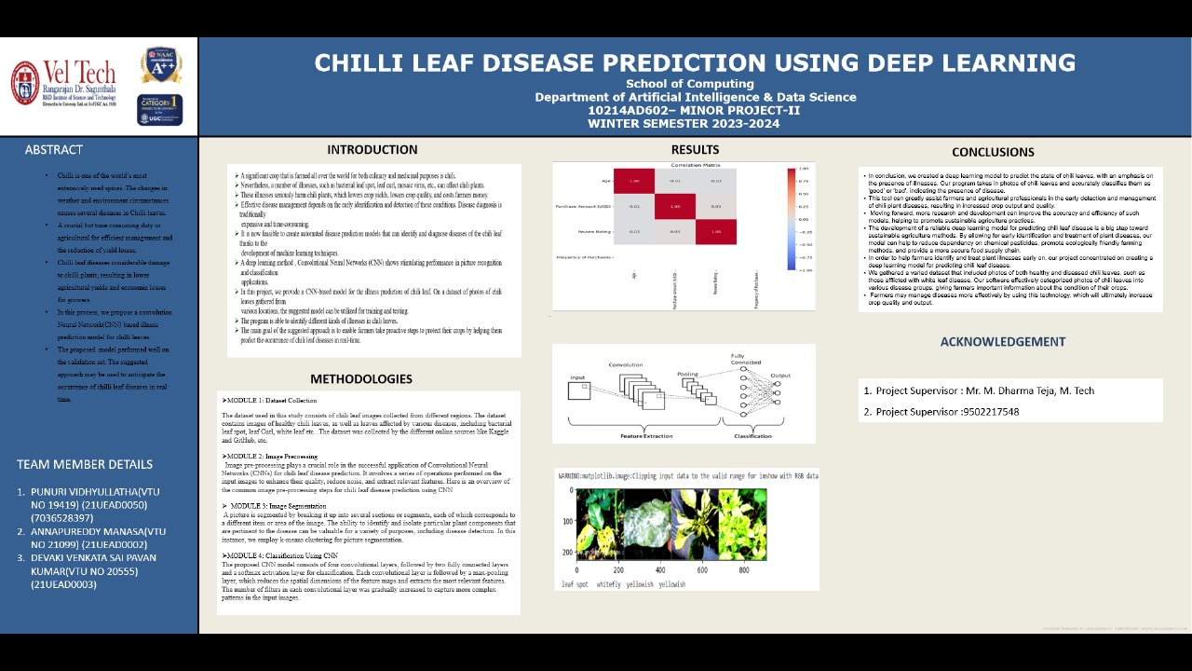
POSTER PRESENTATION

Slide 34
REFERENCES
[1] H SABROL AND K SATISH. "TOMATO plant disease classification in digital images using classification tree". In: Communication and Signal Processing (ICCSP), 2016 International conference on IEEE.2016,PP,1242-1246.
[2] Usama Mokhtar etal. "Sum based detection of tomato leaves diseases".In:Intelligent Systems 2014,Springs, 2015,PP, 641-652.
[3] Rangrajan A. K;Purushothaman R; Ramesh A. Tomato crop disease classification using pte-trained deep learning algorithm. Prcedic comput. Sci, 2018,133,1040-1047.
[4] Razavi.S;Yalcin, H. Using convolutional neural networks for plant classification. In proceedings of the 2017 25th Signal Processing and Communication Applications conference (SIV), Antalya, Turkey, 15-18 may 2017;PP, 1-4.
[5] S. Zhang, W. Huang and C. Zhang, "Three-channel convolution neural networks for vegetable leaf disease recognition".coginitive Systems Research,vol.53,PP. 31-41, 2019.
[6] Amara, J.; Bouaziz, B.; Algergawy, A. A deep learning-based approach for banana leaf diseases classification. In Proceedings of the Datenbanksysteme für Business, Technologie und Web (BTW 2017)—Workshop band, Stuttgart, Germany, 6–10 March 2017. [Google Scholar]
[7] Mohanty, S.P.; Hughes, D.P.; Salathé, M. Using deep learning for image-based plant disease detection. Front. Plant Sci. 2016, 7, 1419. [Google Scholar] [CrossRef] [PubMed] [Green Version]

Slide 35
THANK YOU

